Slide 1

Bespoke Plant & Floral Installations

Slide 2
Who We Are
With over 50 years of experience in horticulture, we founded Expo Plant & Bloom to bridge the gap between professional event design & sustainable greenery solutions.
Having worked closely with 200+ leading stand builders & exhibition professionals at events throughout the UK, Europe and US. We understand the need for hassle-free, high impact plant installations that not only enhance stand aesthetics but also improve your visitor engagement.
Sustainable, modern & design-led – ensuring a seamless premium experience from design to installation.

Slide 3
Our Services
Exhibition Stand Plants & Flowers – Custom, high-quality plant and floral displays tailored to your brand.
Custom Planters & Installations – Unique, made-to-measure solutions to complement stand designs.
Fully Bespoke Designs - Crafted uniquely for each brand, event, and space
Greenery Design & Consultancy – Expert design guidance to bring your vision to life.

Slide 4
Sustainability Approach
Locally sourced seasonal florals and plants
Reuse rotational pot & planter systems
Carbon-considered logistics
Donation & redistribution strategy post‑event
Environmentally conscious solutions without compromise on design

Slide 5
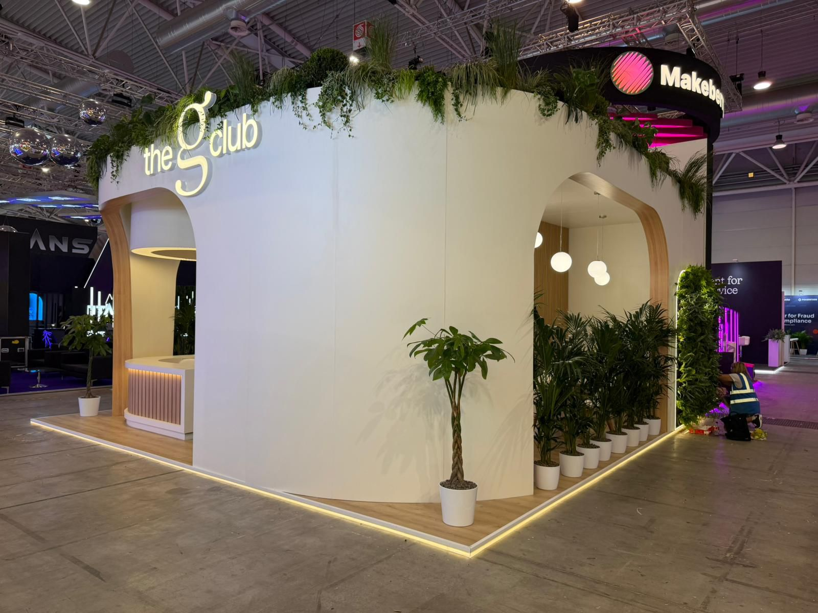
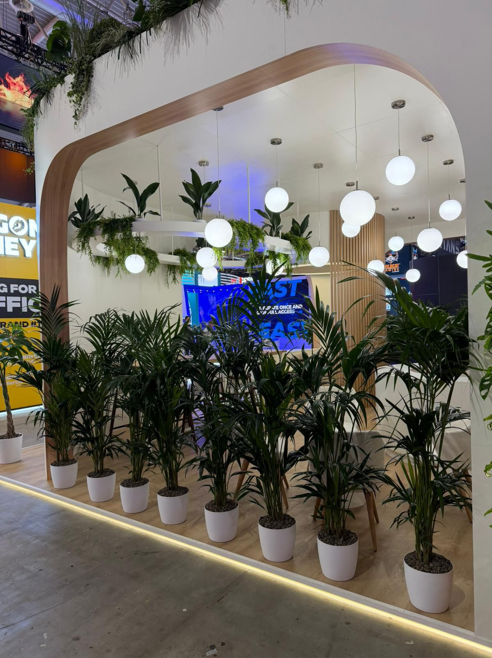
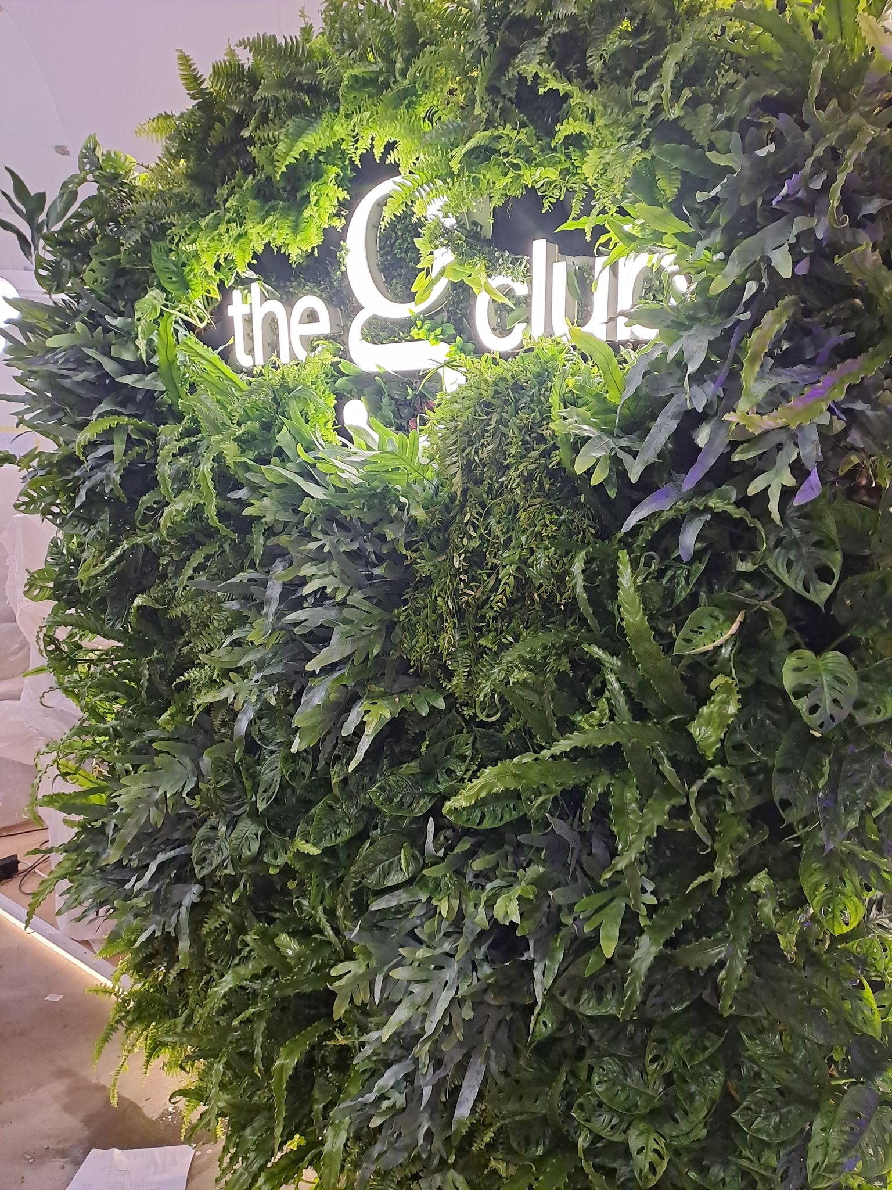
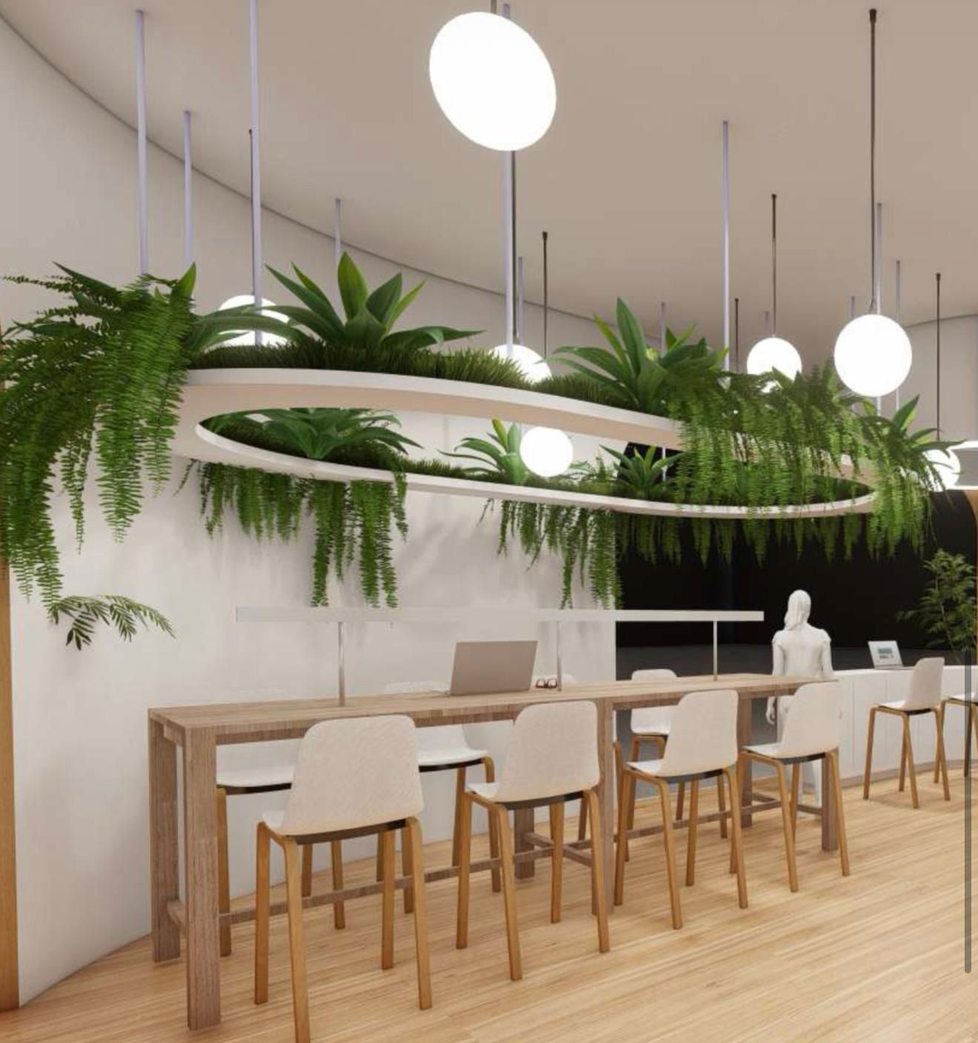
G Club – Sigma, Rome
2025

Slide 6
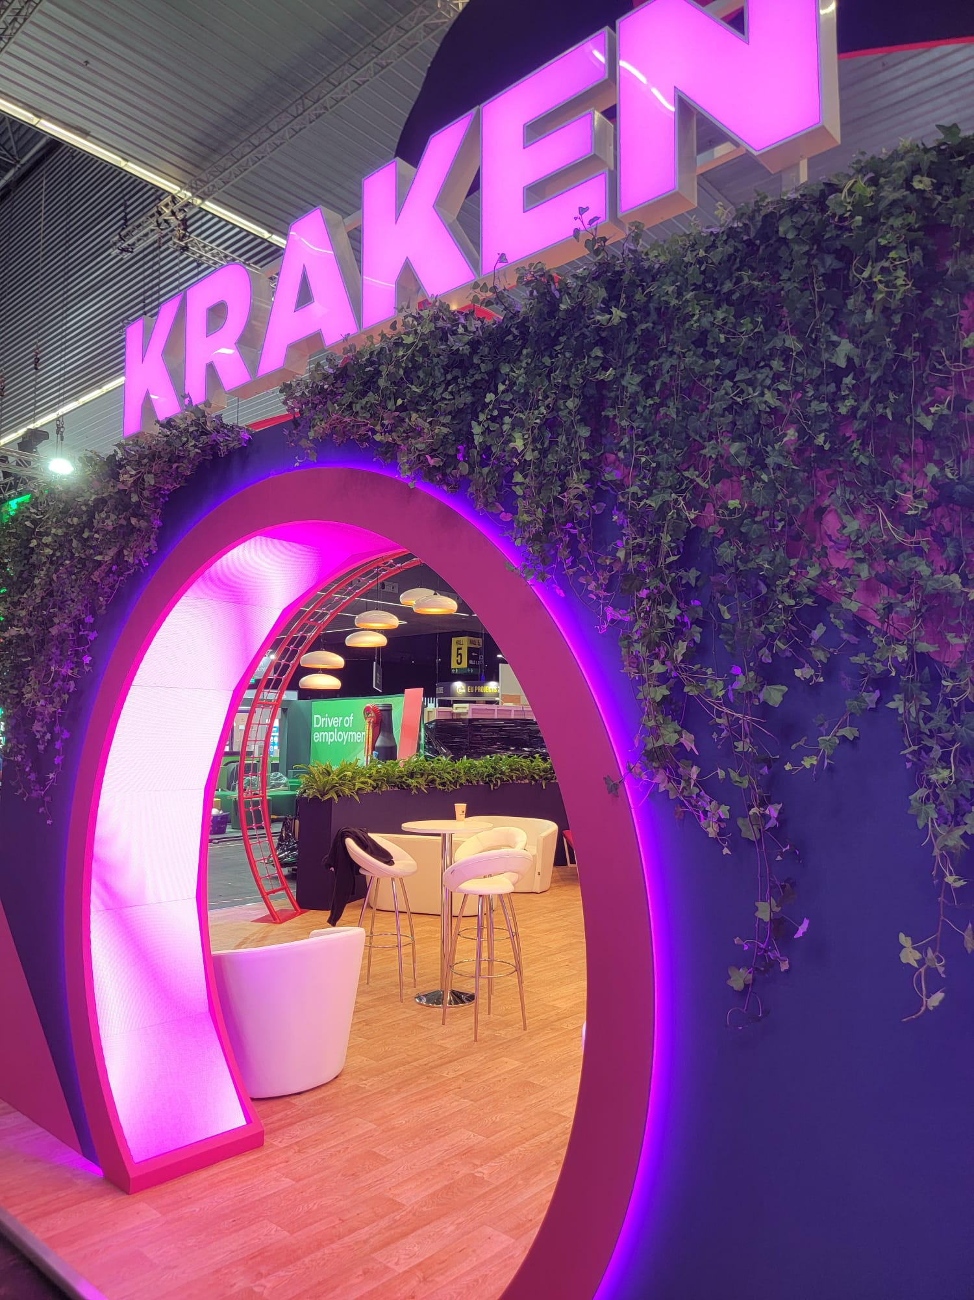
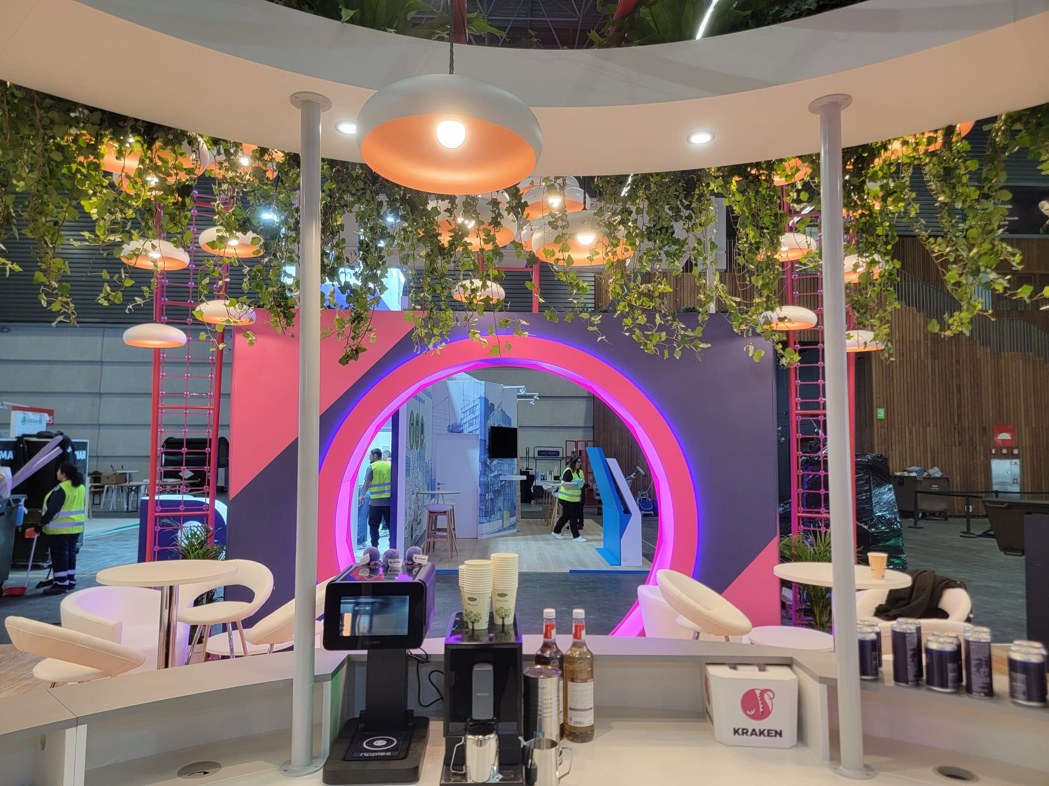
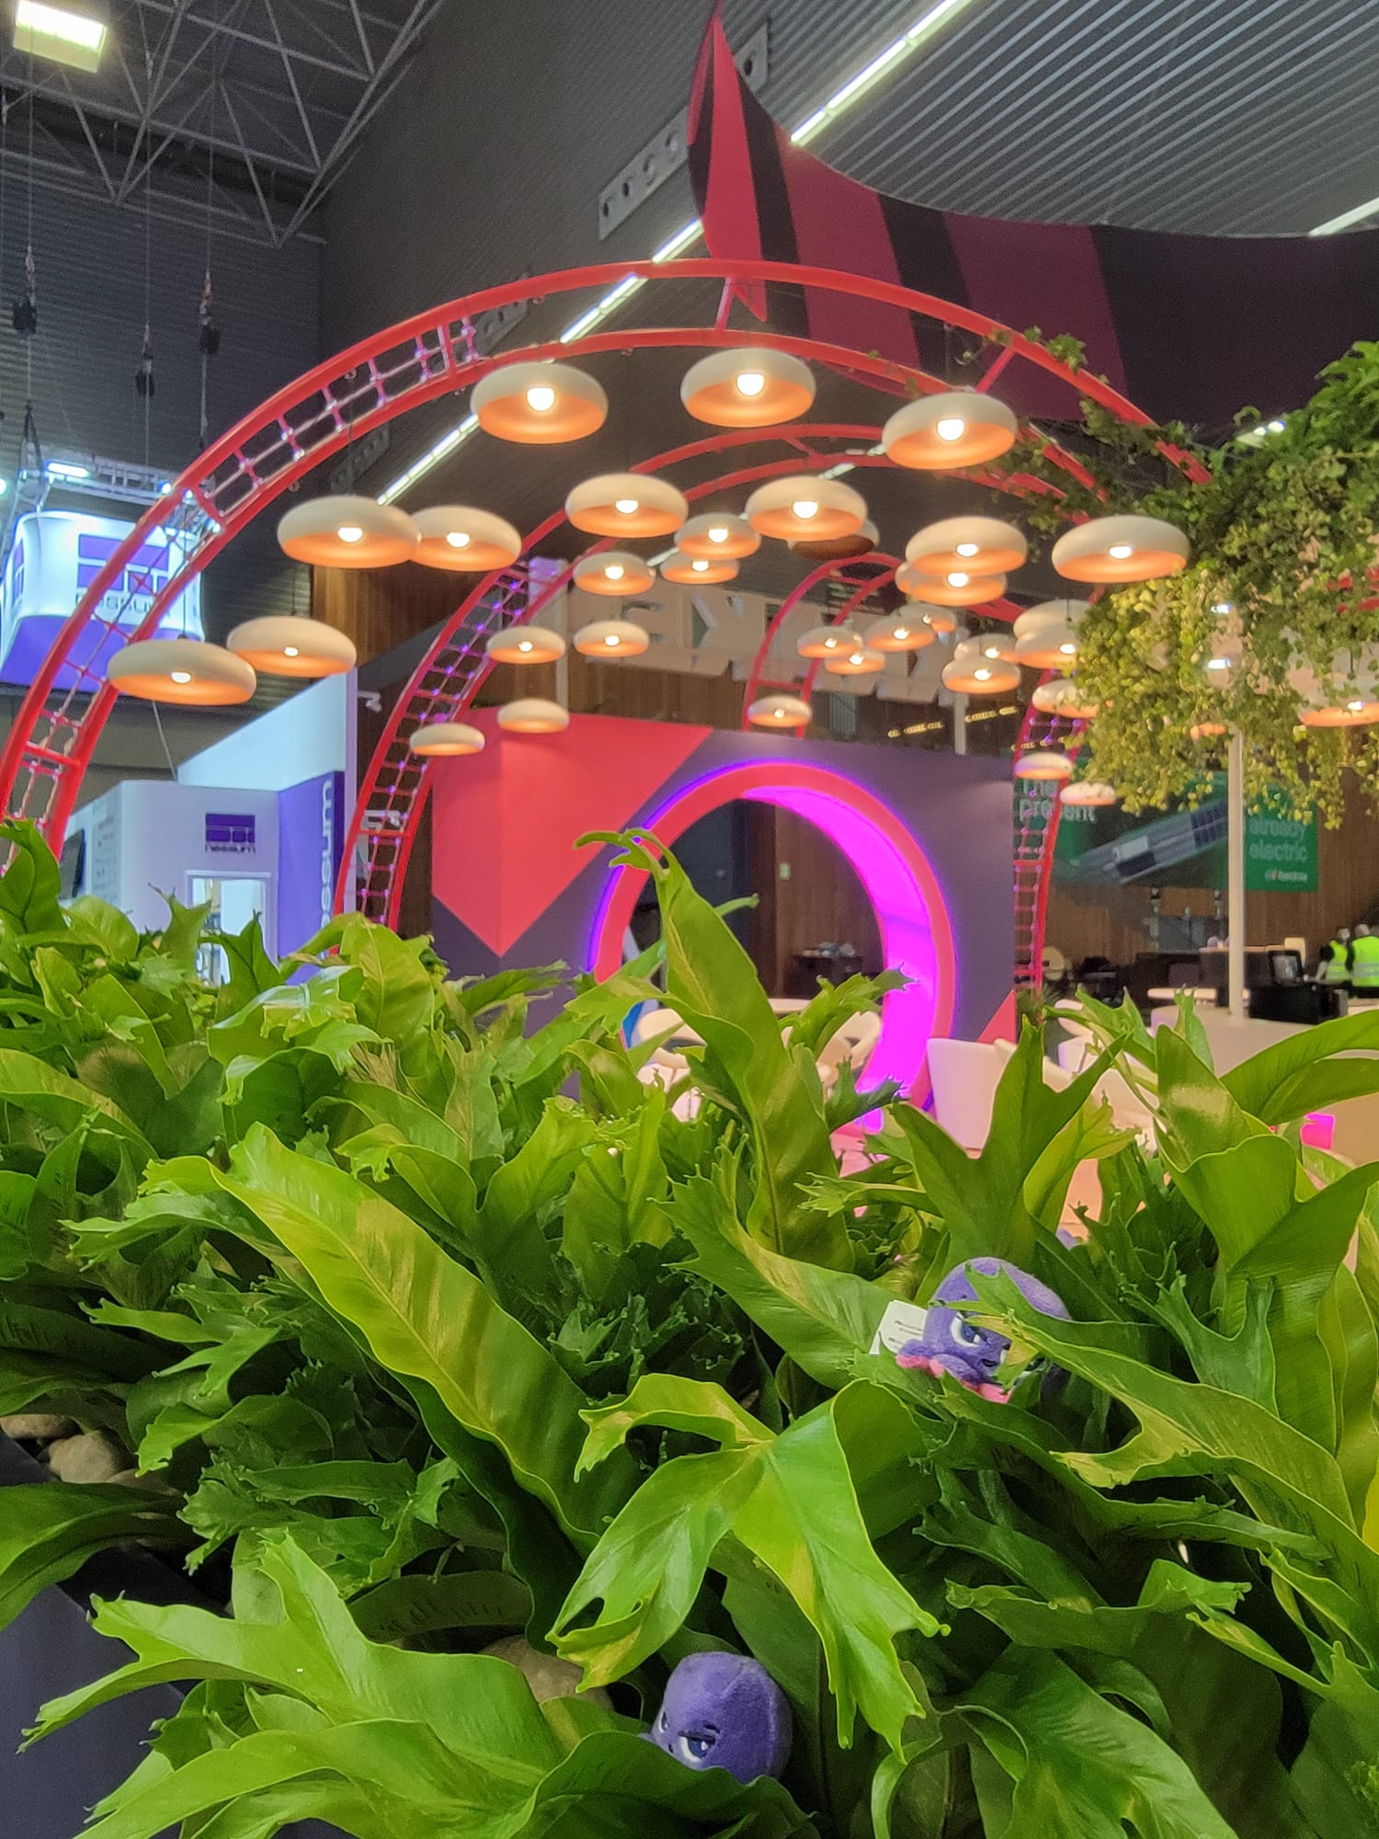
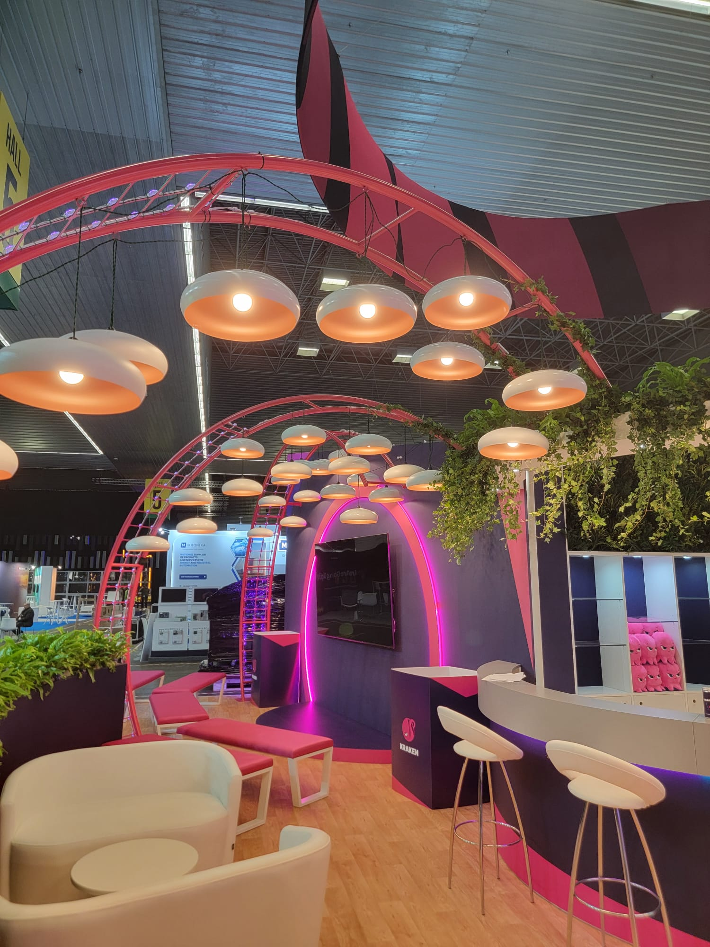
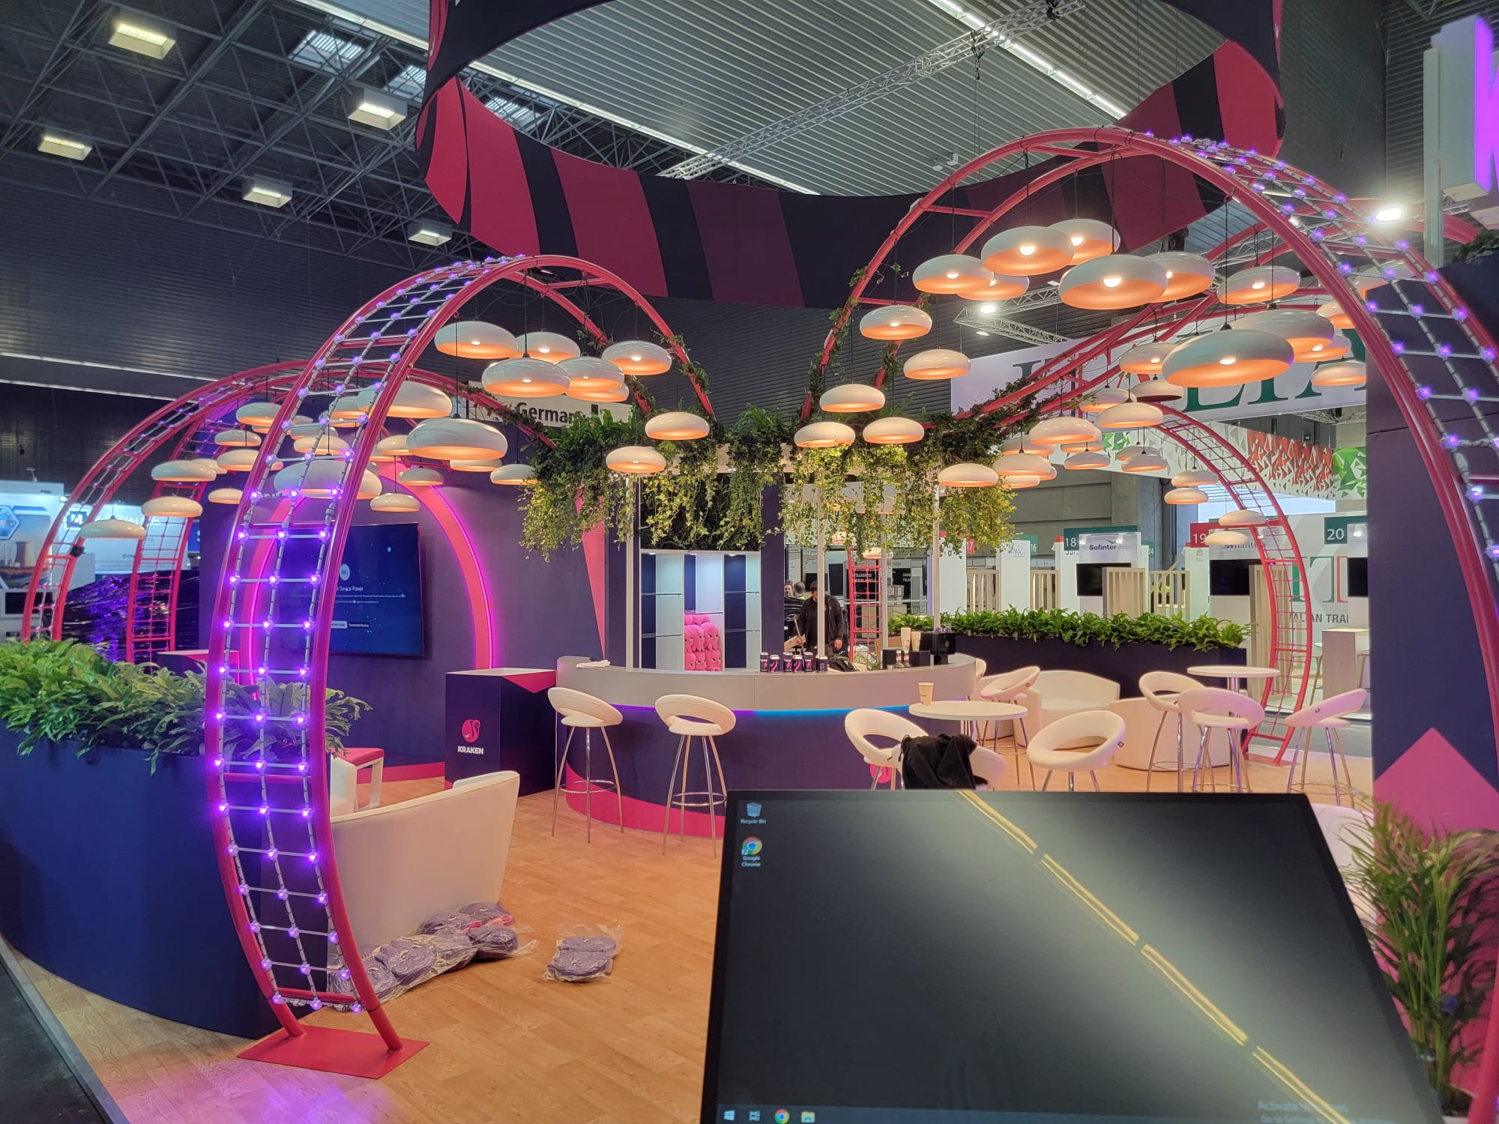
Kraken – Enlit, Bilbao 2025

Slide 7
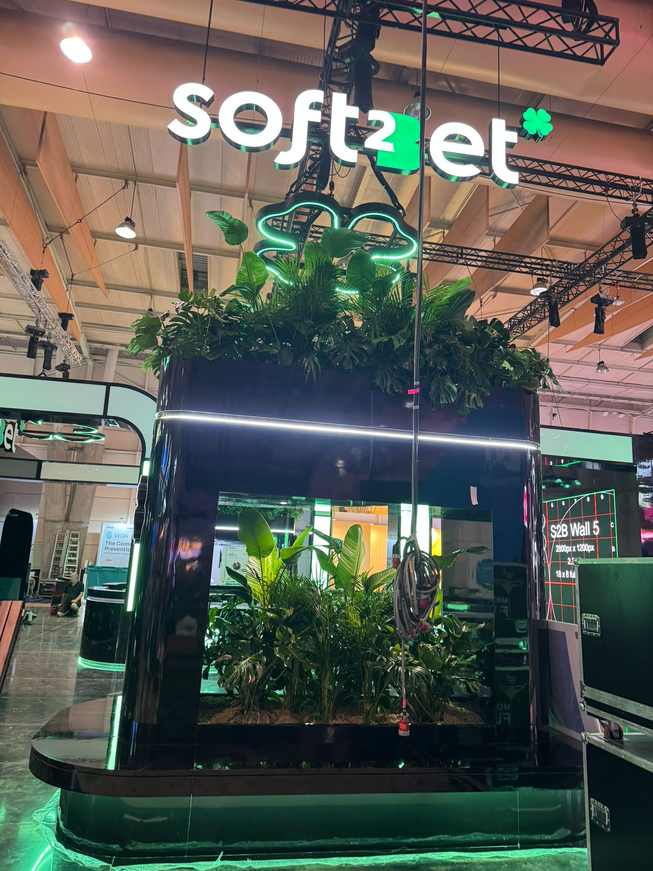
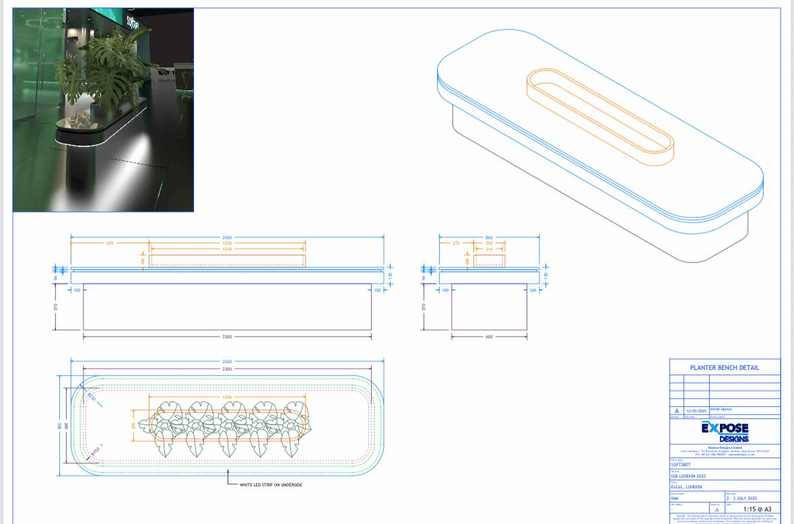
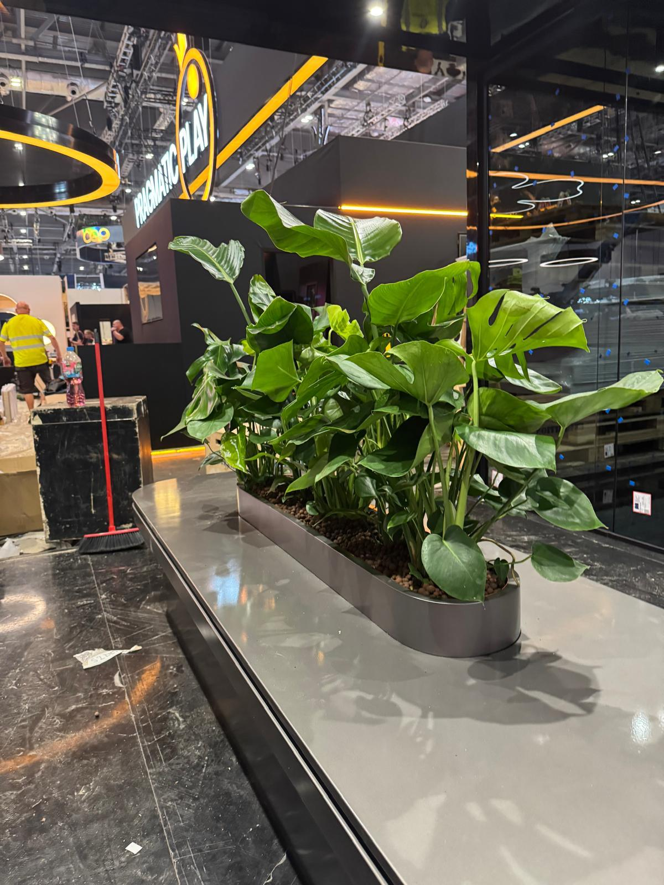
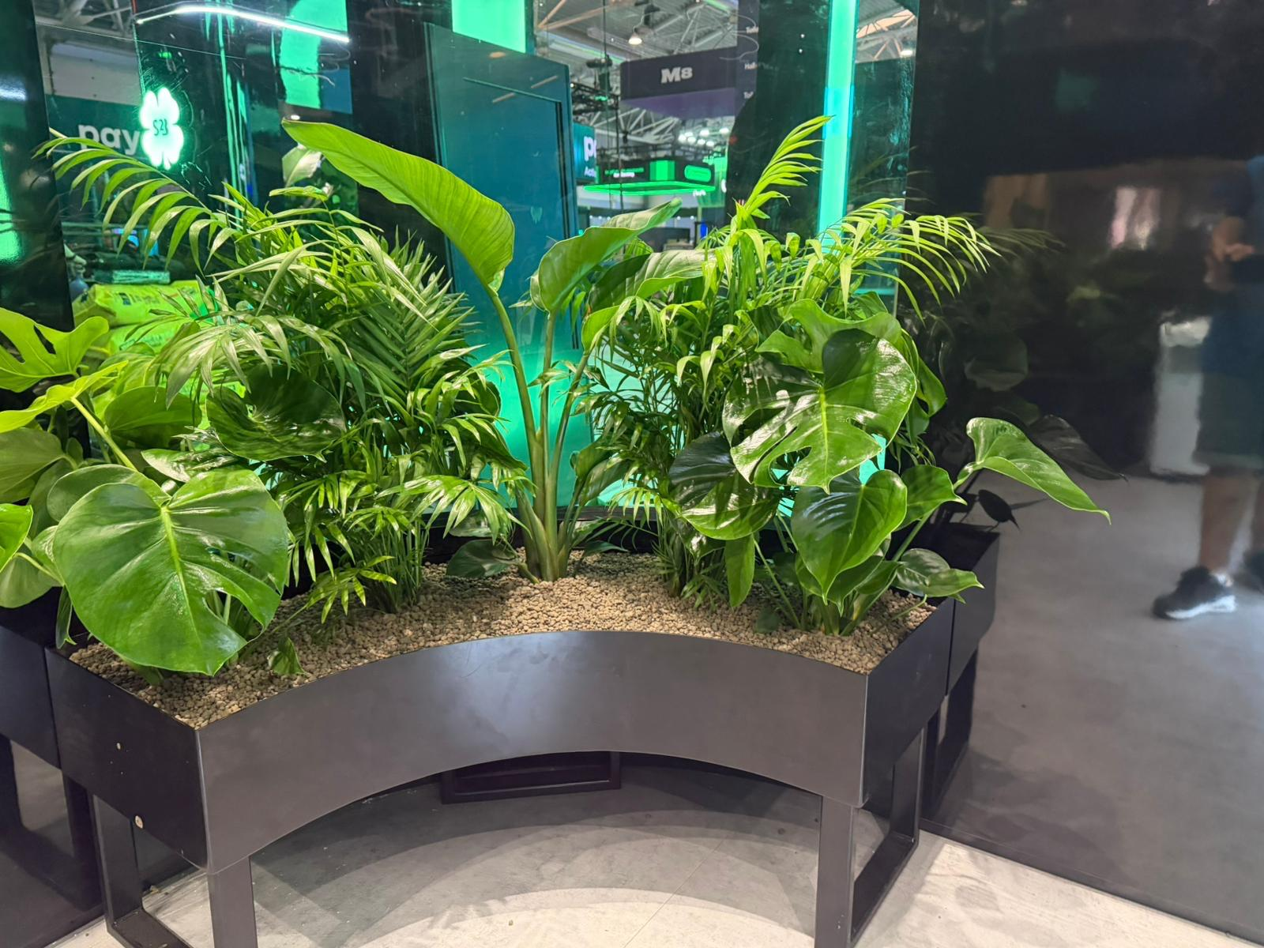
Soft2Bet –
ICE, London 2025

Slide 8
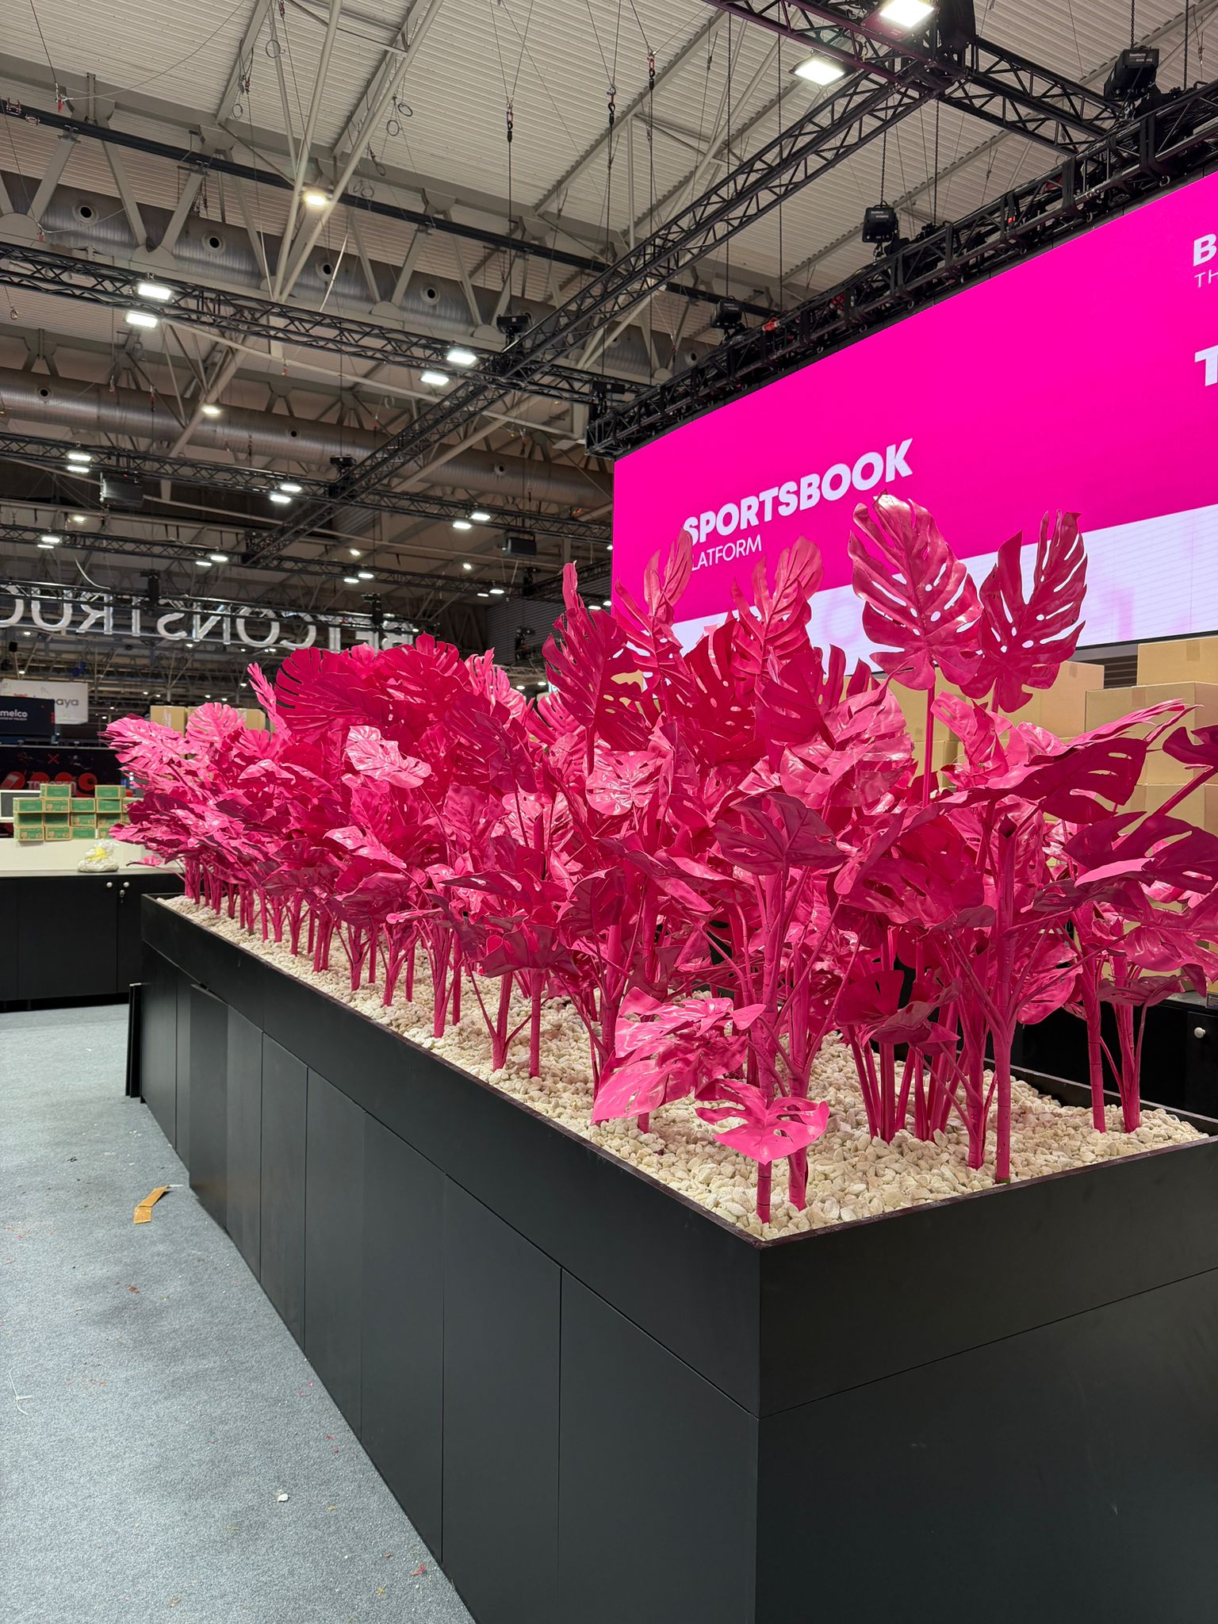
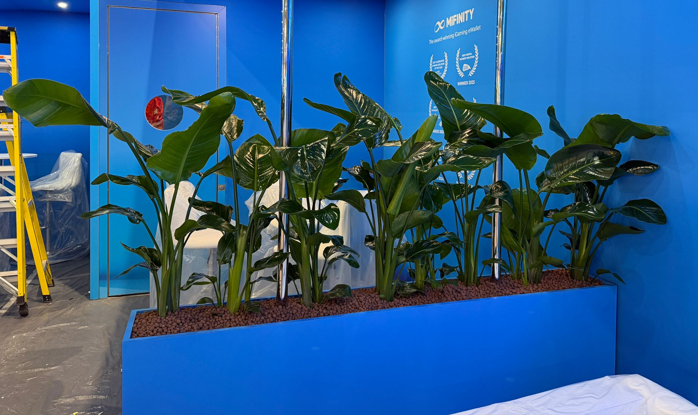
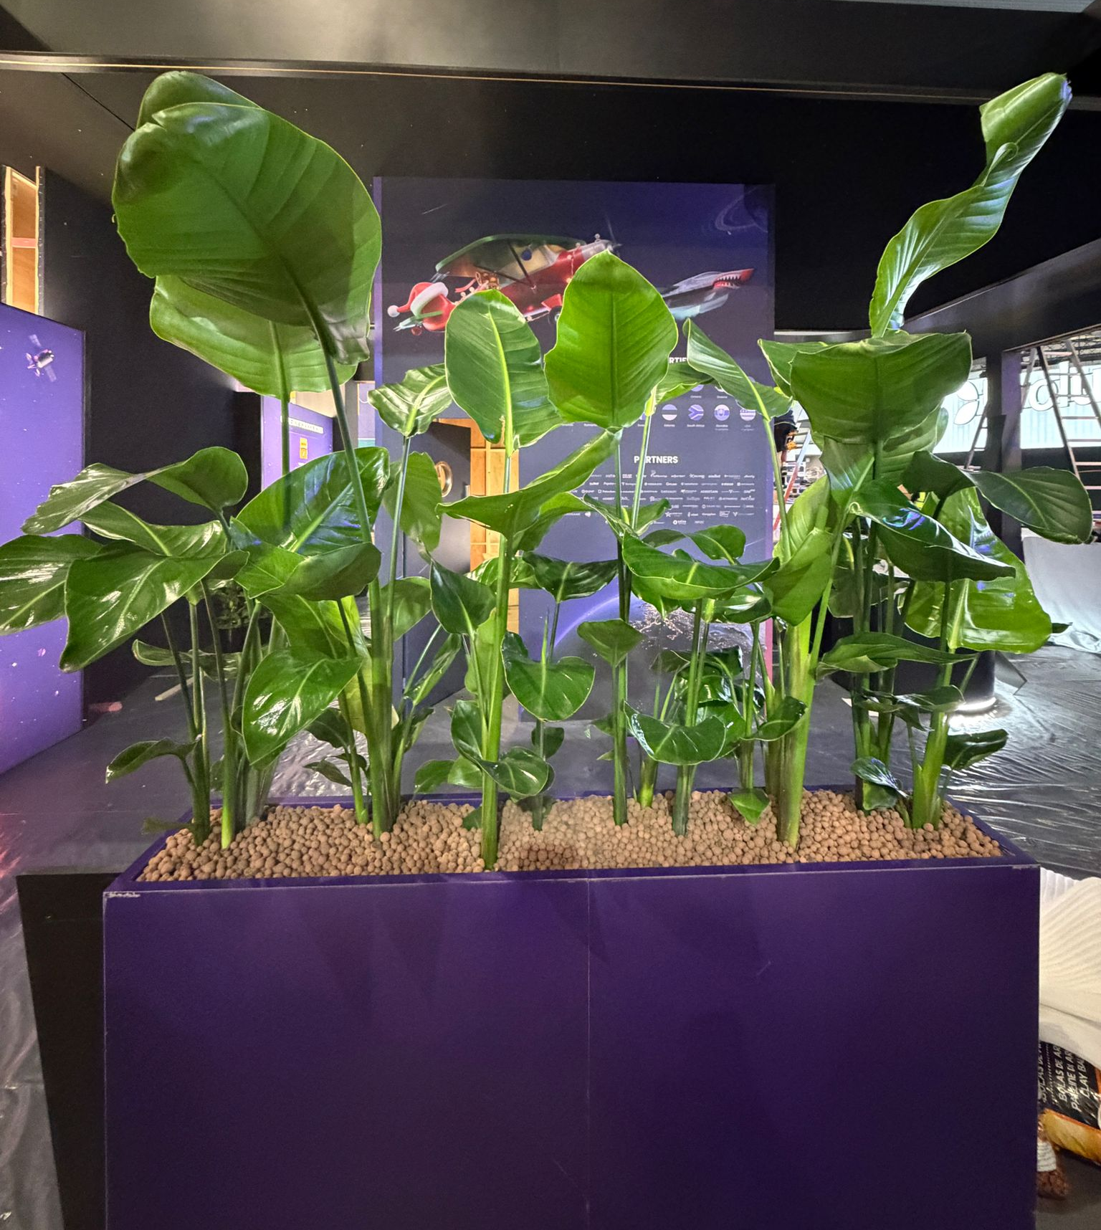
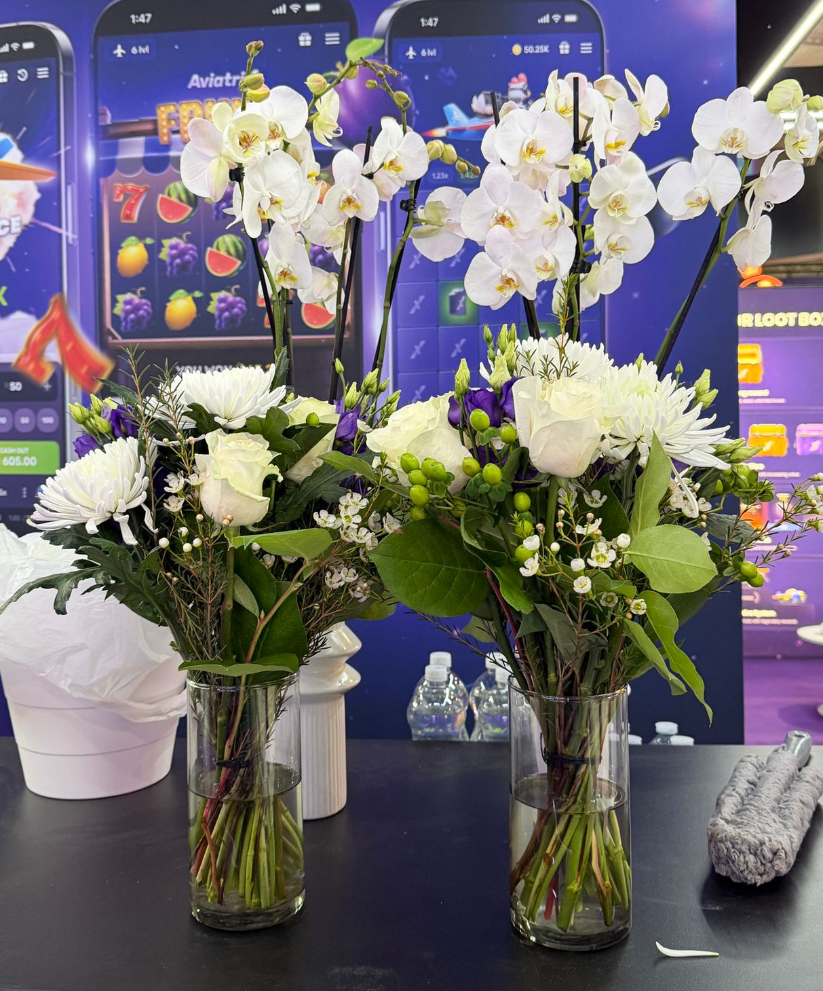
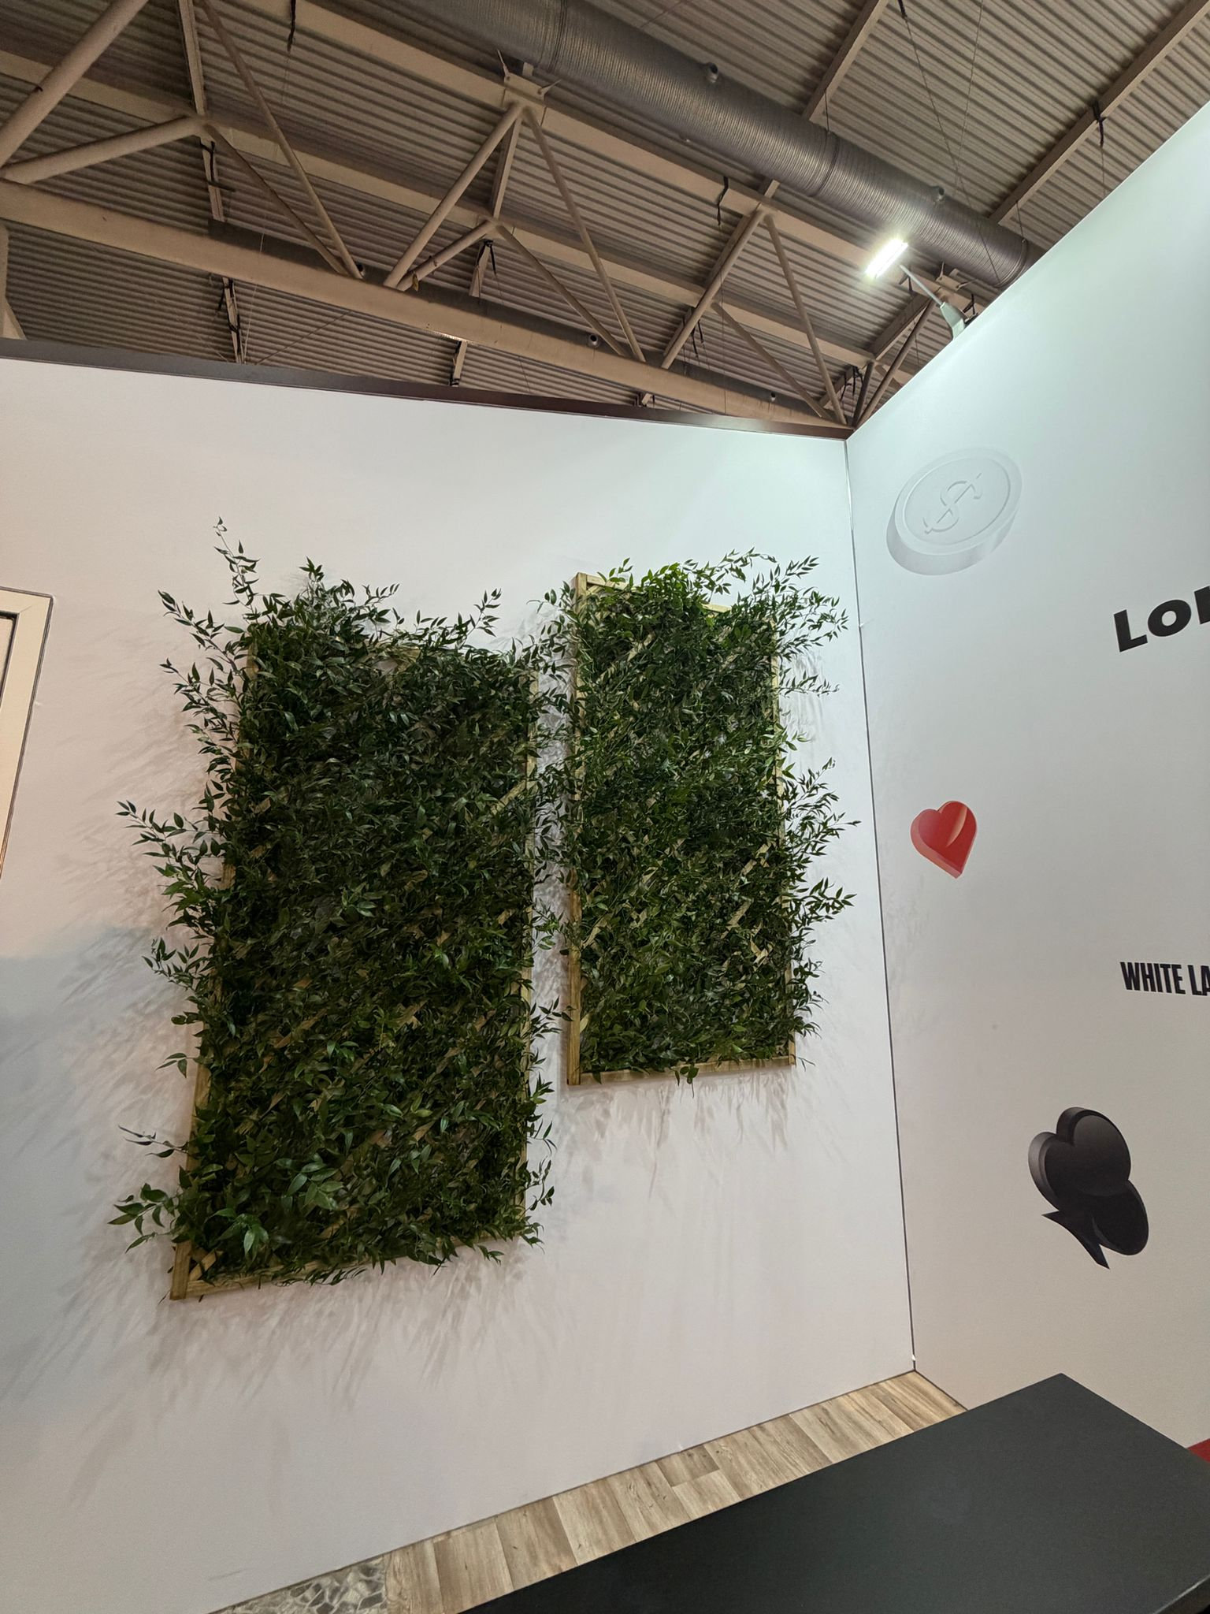
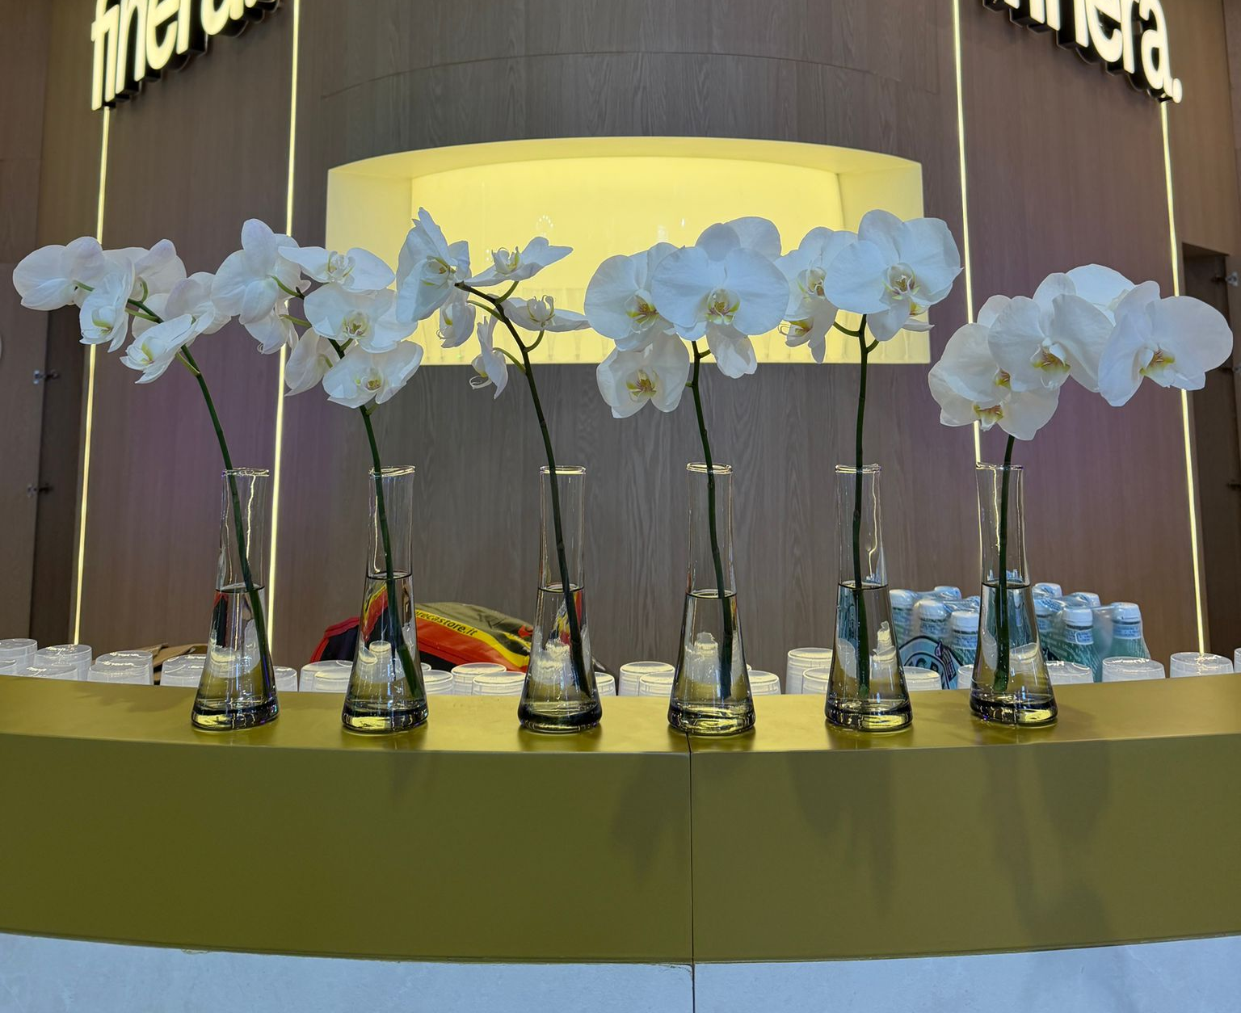
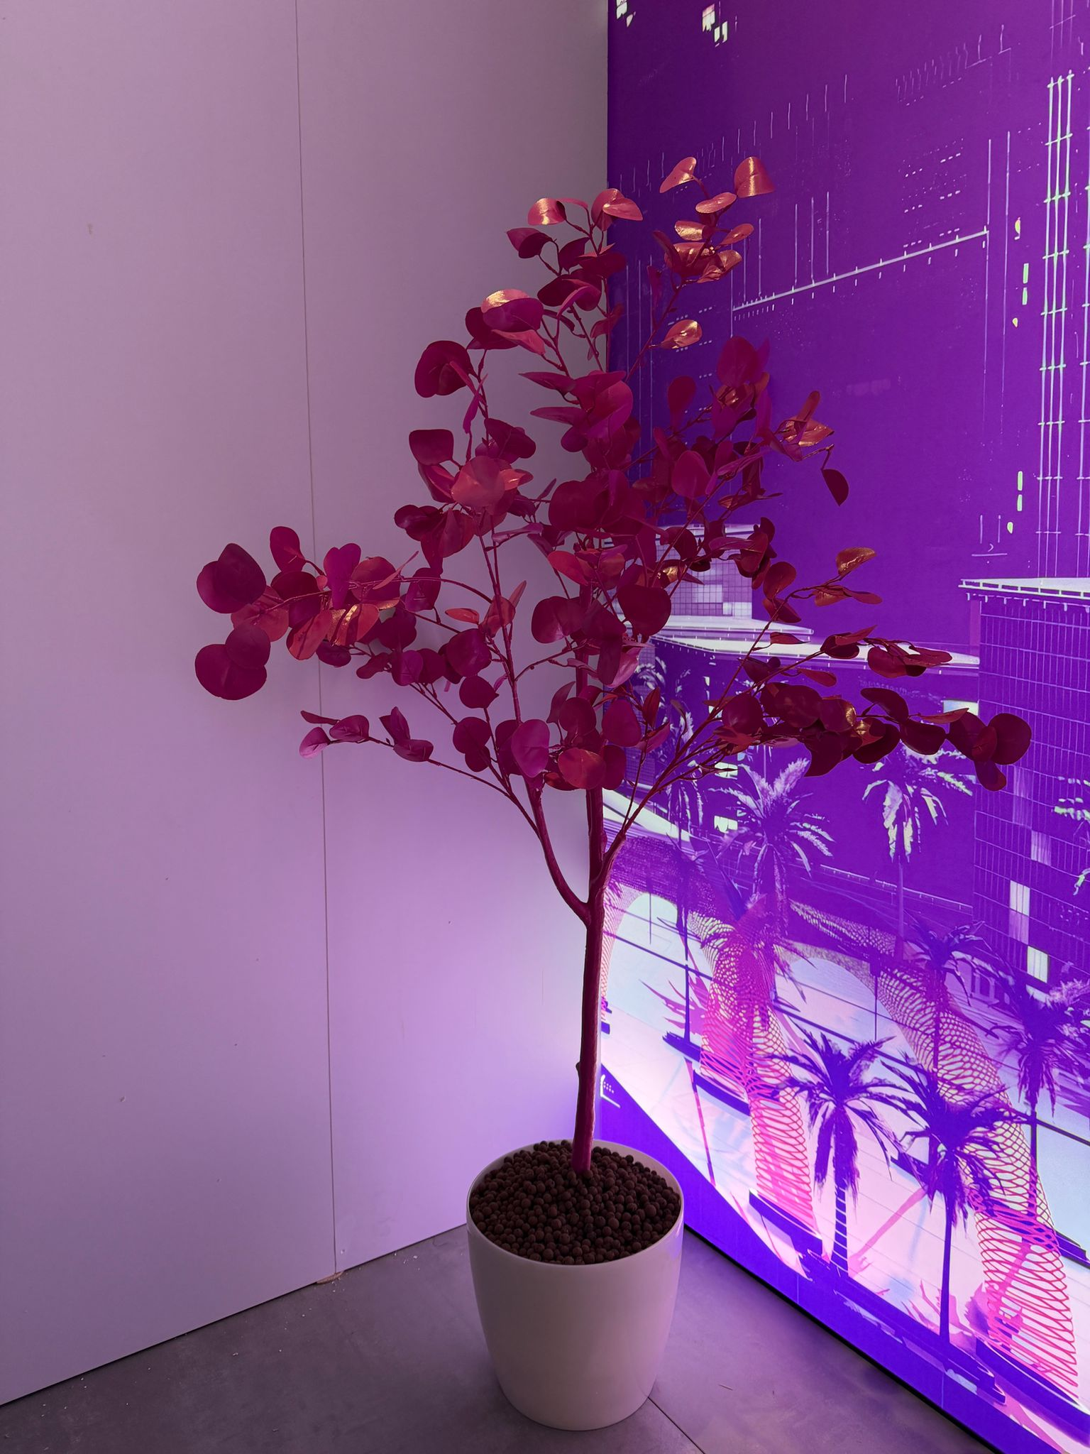
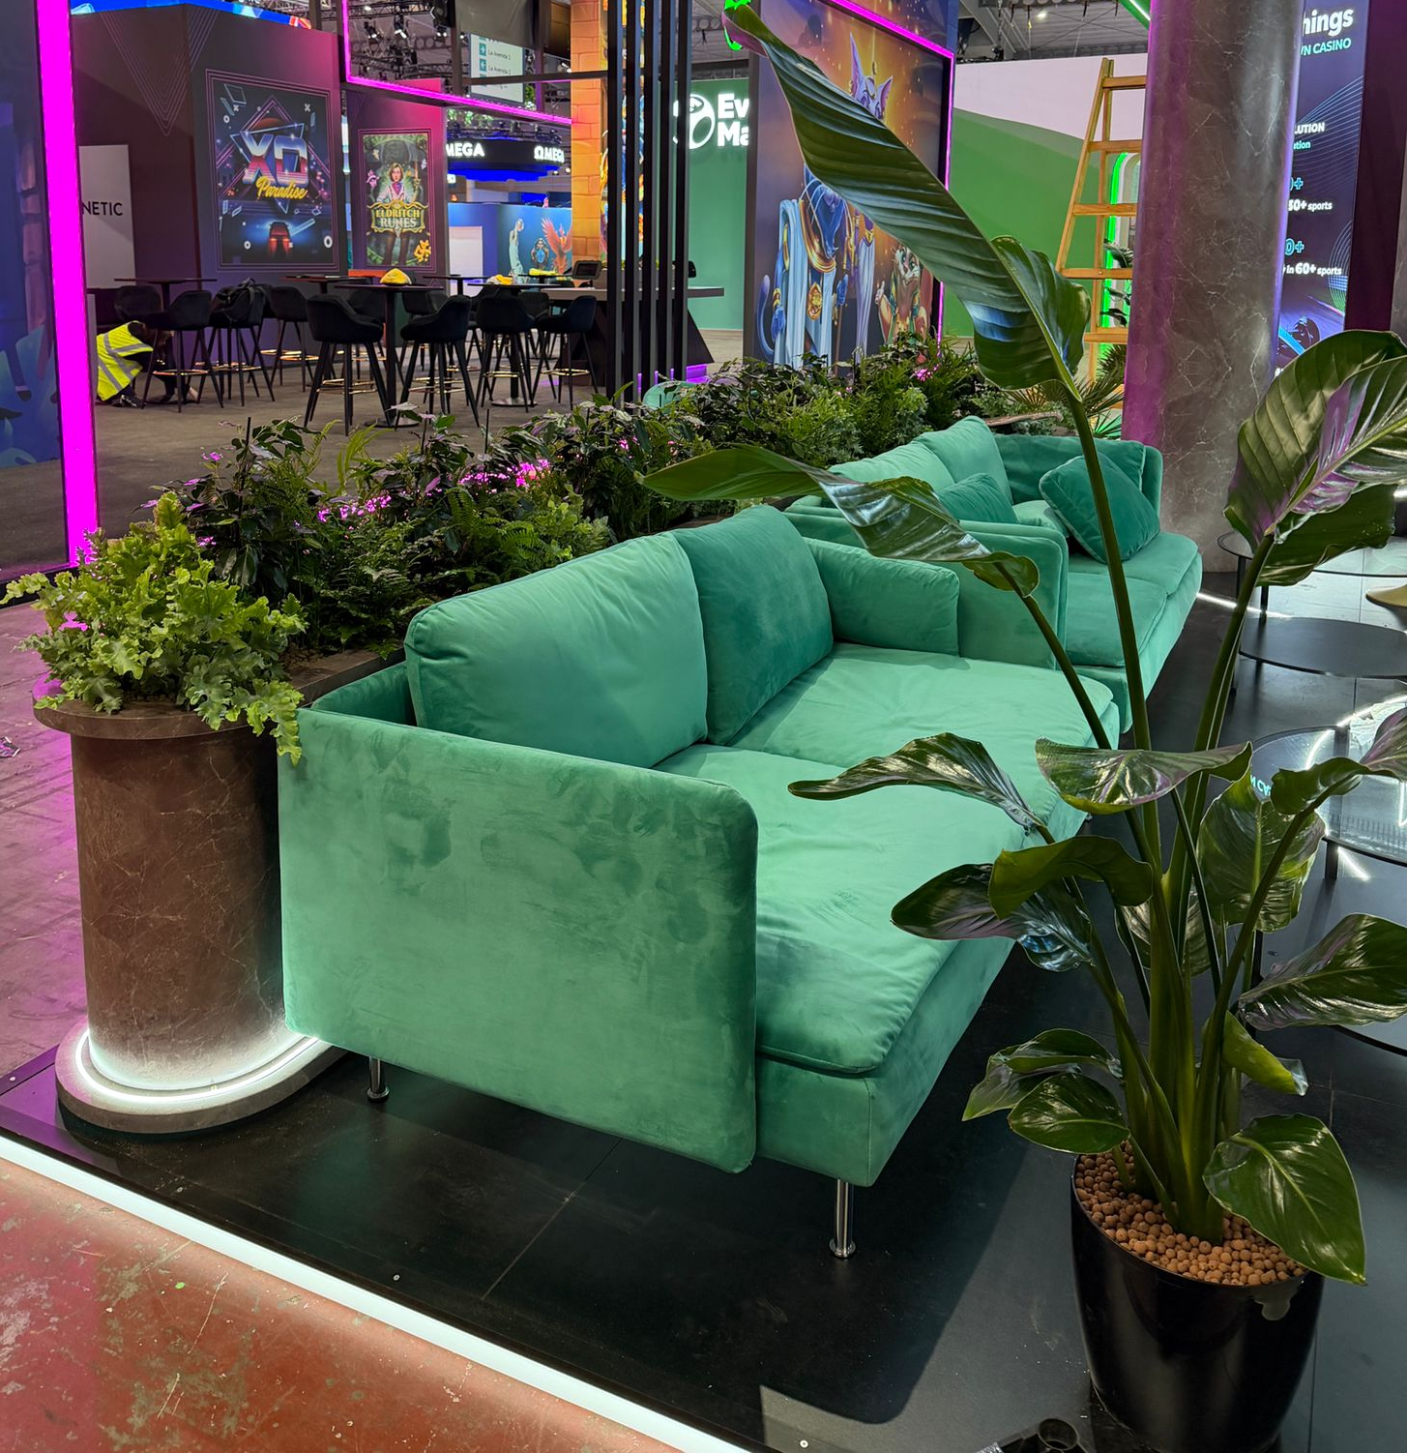
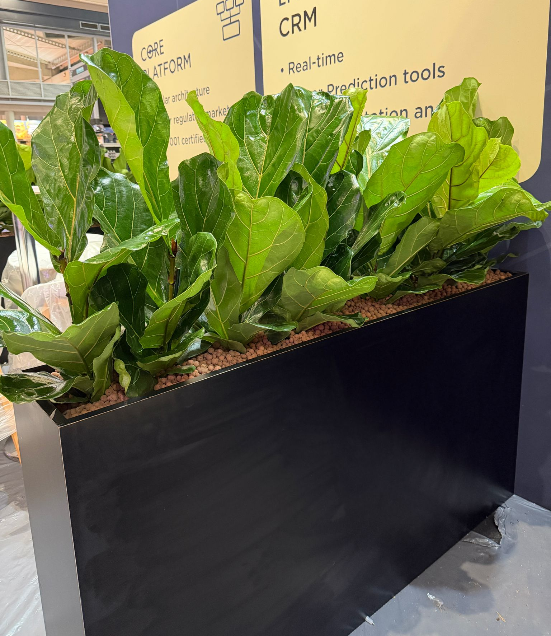
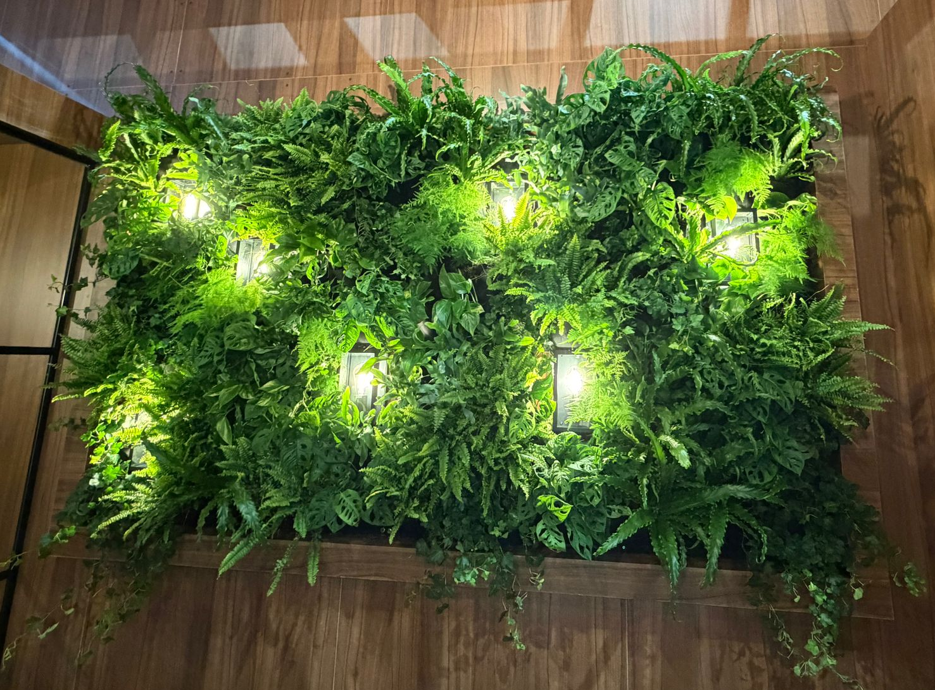
ICE, –
Barcelona 2026

Slide 9
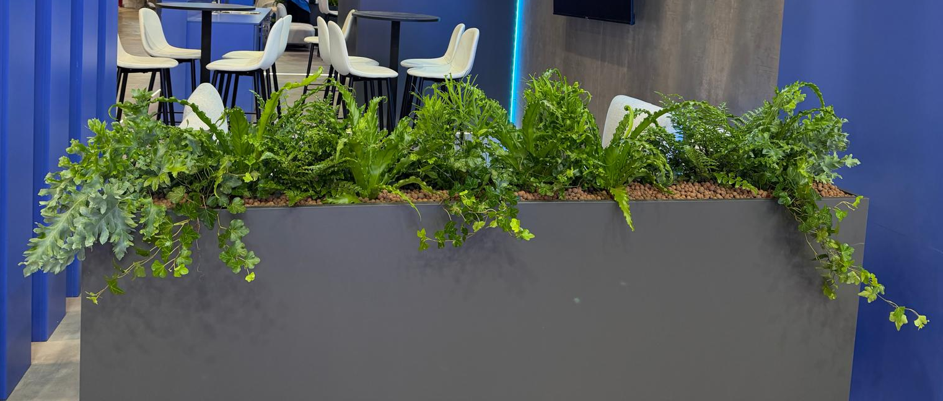
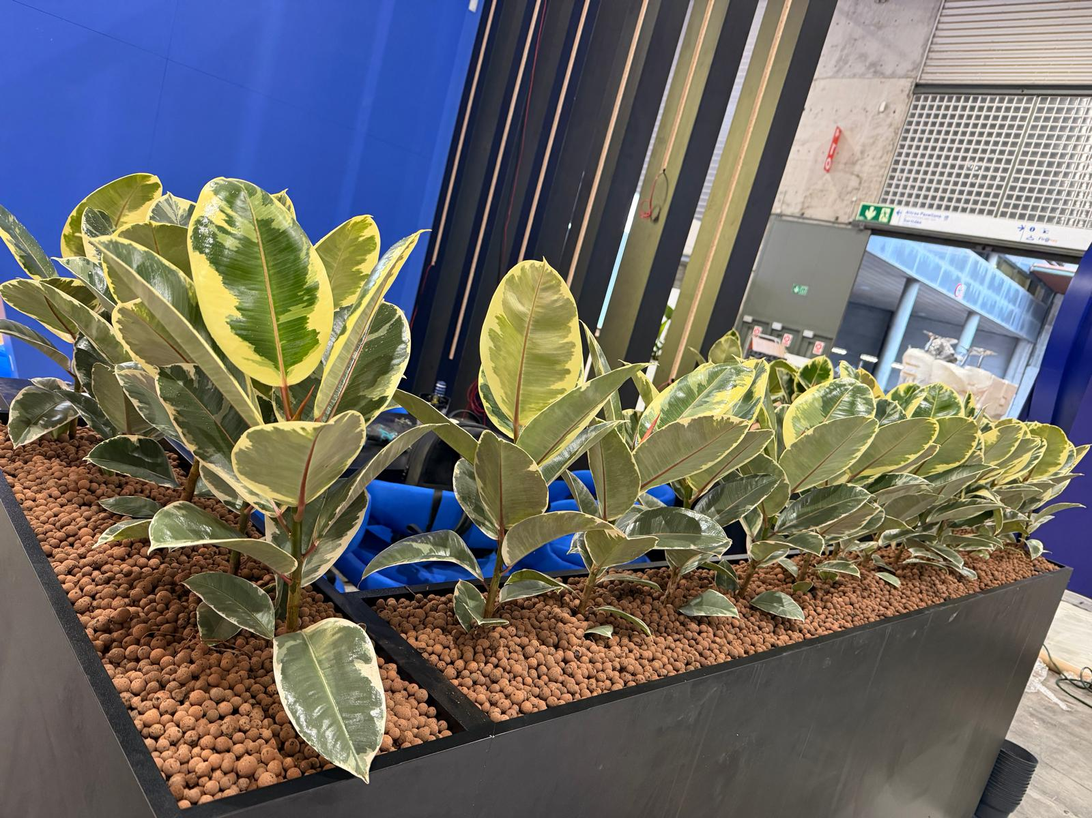
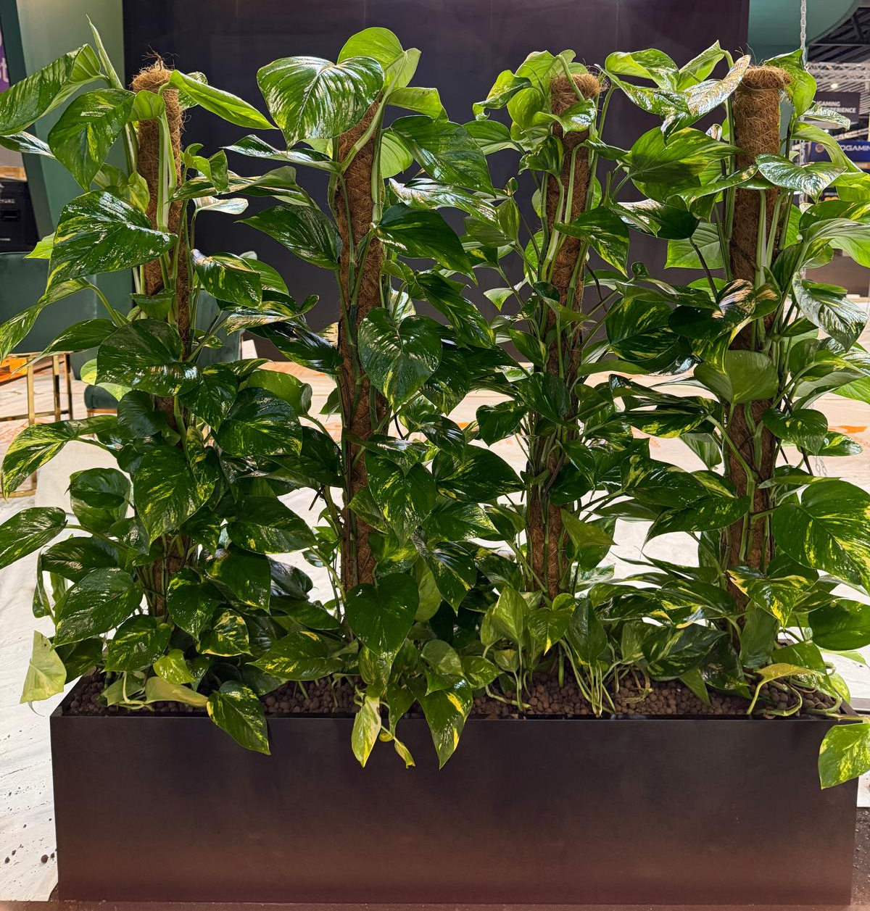
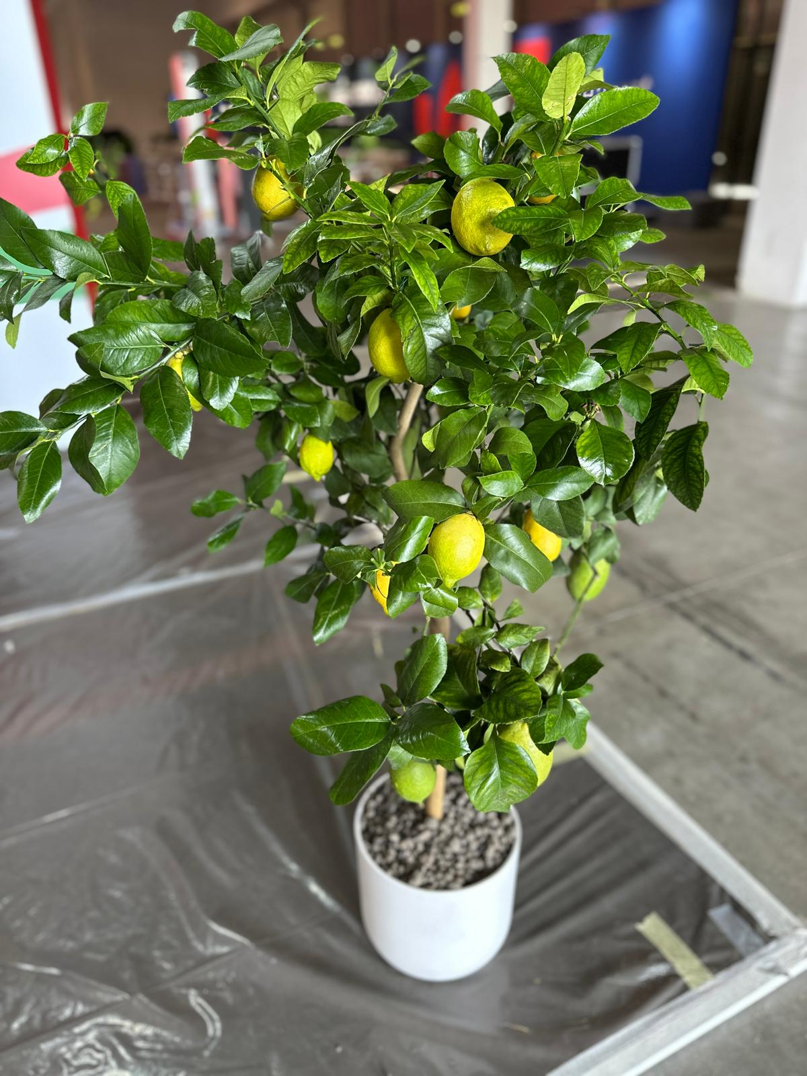
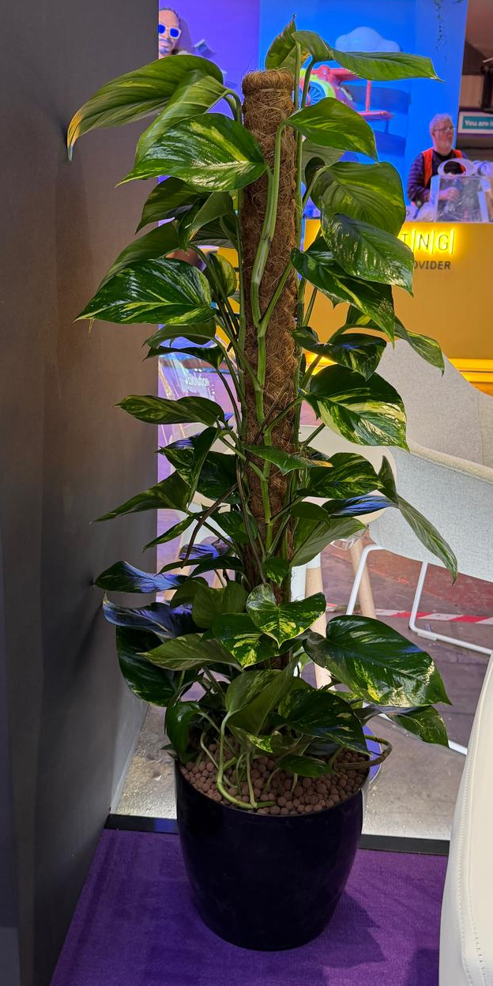
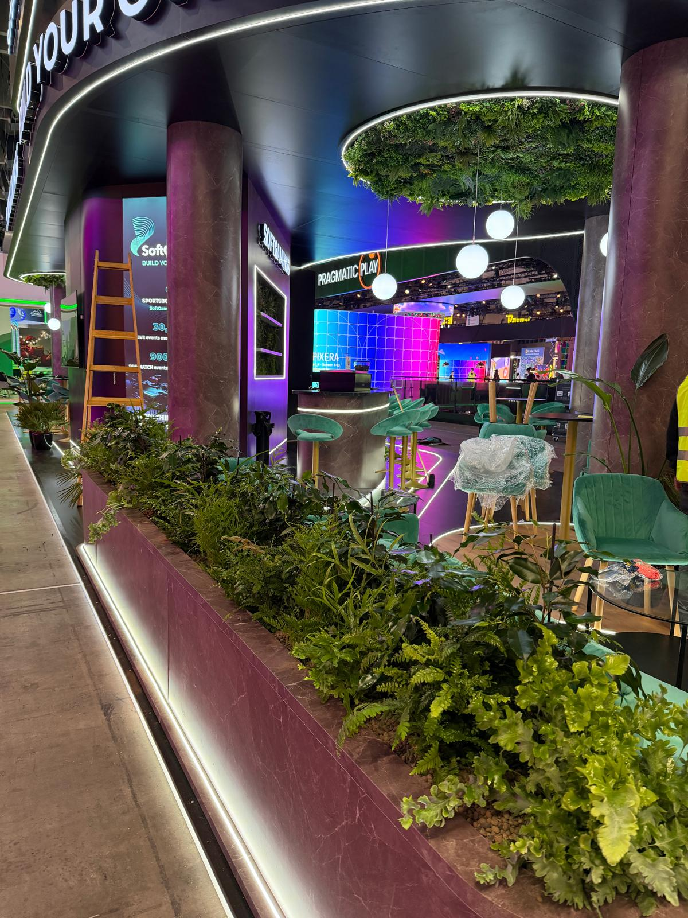
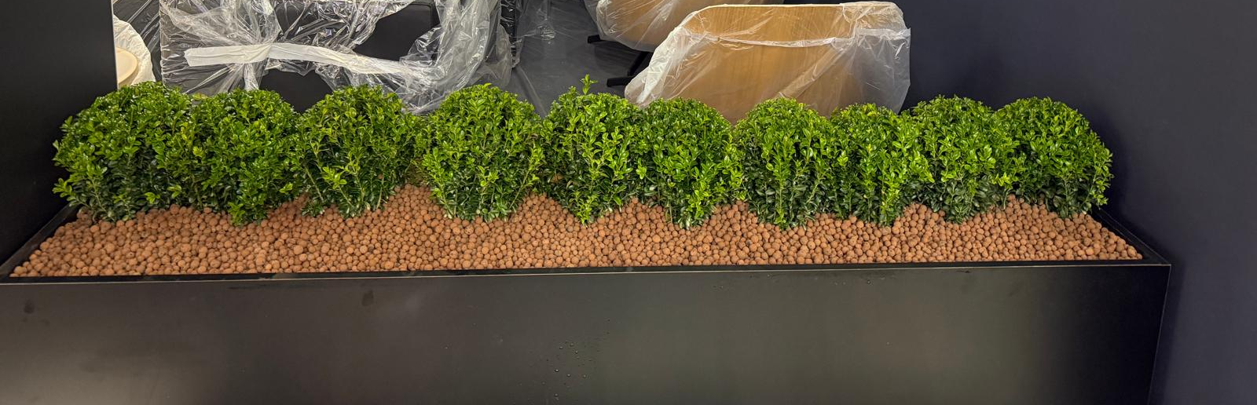
ICE, –
Barcelona
2026

Slide 10
Key Achievements
Delivered 85+ exhibition stands across major industry expos in the last 6 months.
Most recently over 35 stands at ICE, Barcelona (Jan 2026)
All projects delivered to tight, immovable deadlines
Consistently praised for clean, tidy, and well-presented builds on-site
Known for a prompt, reliable approach from install through breakdown
Maintained high standards across multiple locations, teams, and time zones
Proven ability to scale quickly while maintaining quality and attention to detail

Slide 11
Why Us?
Reliable, professional service – delivering and installing on time, every time.
Elevate event atmosphere and guest experience
Tailored plant and floral designs to reflect your brand’s personality and event theme.
Add sensory, interactive, and visual impact
Scalable for global experience-level events
We never subcontract work out – we have our own inhouse team that carries each project out from start to finish.

